Slide 1
Introductory Discussion on Design Pattern

Slide 2
What is a software design pattern?
A standard solution to a common programming problem
a design or implementation structure that achieves a particular purpose
a high-level programming idiom
It is a description or template for how to solve a problem that can be used in many different situations
A technique for making code more flexible or efficient
reduce coupling among program components
reduce memory overhead
Shorthand for describing program design
a description of connections among program components

Slide 3
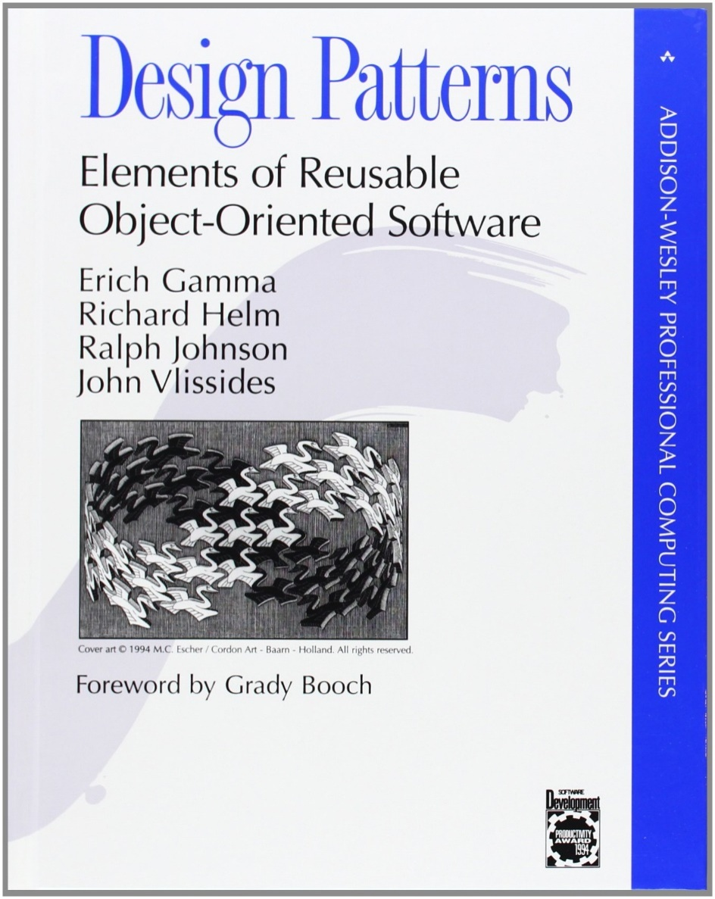
Gang of Four
23 design patterns
Three categories:
Creational
Structural
Behavioral

Slide 4
Creational Patterns
How objects are instantiated
Five creational patterns
Factory method
Abstract factory
Builder
Prototype
Singleton

Slide 5
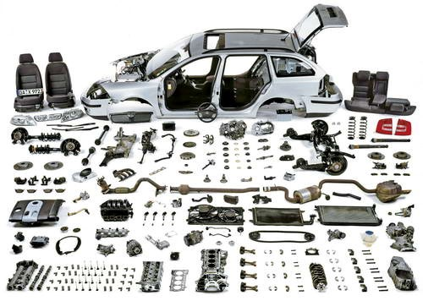
Structural Patterns
How objects / classes can be combined
Seven structural patterns
Adapter
Bridge
Composite
Decorator
Façade
Flyweight
Proxy

Slide 6

Behavioral Patterns
How object communicate
11 behavioral patterns
Interpreter
Template Method
Chain of Responsibility
Command
Iterator
Mediator
Memento
Observer
State
Strategy
Visitor

Slide 7
Essential Elements of a Design Pattern
Intent | Design goals of a pattern
Problem | Describes when to apply the pattern Explains the problem and its context
Solution | Elements that make up the design Relationships and collaborations among the elements
Consequences | Benefits Trade-offs

Slide 8
Why needed
Requirements always change. Requirements change for a very simple set of reasons:
• The users’ view of their needs change as a result of their discussions with developers and from seeing new possibilities for the software.
• The developers’ view of the users’ problem domain changes as they develop software to automate it and thus become more familiar with it.
• The environment in which the software is being developed changes.

Slide 9
Why needed
Rather than complaining about changing requirements, we should change the development process so that we can address change more effectively.
The design of software should be able to accommodate many possible changes.
Design patterns help to write codes that can accommodate changes easily.

Slide 10
Reasons to study Design Pattern
Reuse existing, high-quality solutions to commonly recurring problems.
Establish common terminology to improve communications within teams.
Shift the level of thinking to a higher perspective.
Decide whether I have the right design, not just one that works.
Improve individual learning and team learning.
Improve the modifiability of code.
Facilitate adoption of improved design alternatives, even when patterns are not used explicitly.
Discover alternatives to large inheritance hierarchies.

Slide 11
Modularity
First approach to deal with change request is to write codes in modular way. Modularity definitely helps to make the code more understandable, and understandability makes the code easier to maintain.
But modularity does not always help code deal with all of the variation it might encounter.

Slide 12
Other Approaches
Cohesion refers to how closely the operations in a routine are related.
Coupling refers to “the strength of a connection between two routines.
Coupling is a complement to cohesion. Cohesion describes how strongly the internal contents of a routine are related to each other.
Coupling describes how strongly a routine is related to other routines.
The goal is to create routines with internal integrity (strong cohesion) and small, direct, visible, and flexible relations to other routines (loose coupling).

